Slide 1
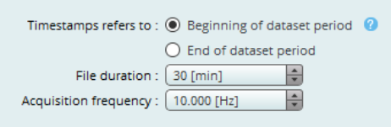
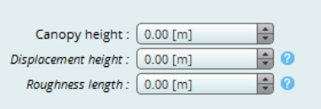
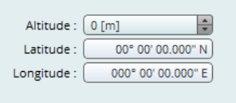
Station information
Depends on us
Depends on us
10 Hz
17.0 meters
8.5 meters
2.20 meters
34 m
39.917 N
-74.597 E

Slide 2
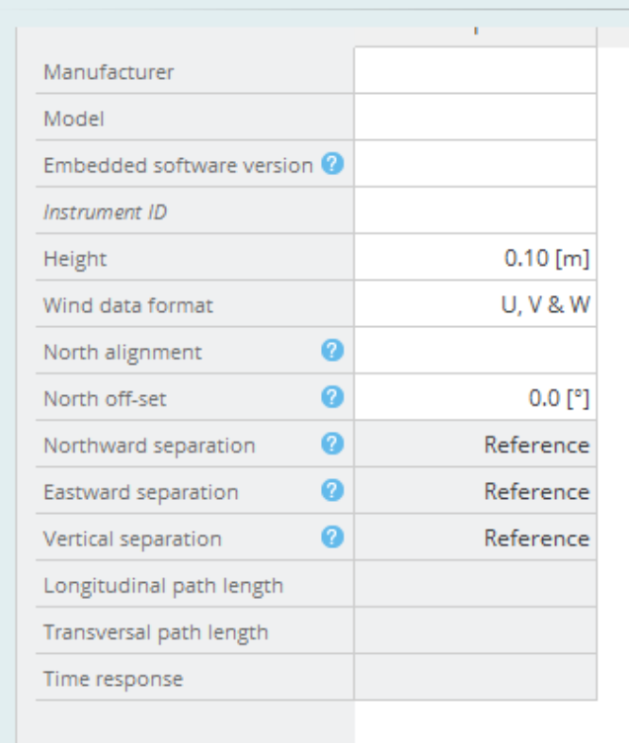
Instruments, part 1
19.5 m
U,V,W
True North
0°
Not sure what they are asking for here. If its sensor head separation from the center, maybe try 5.0 cm?

Slide 3
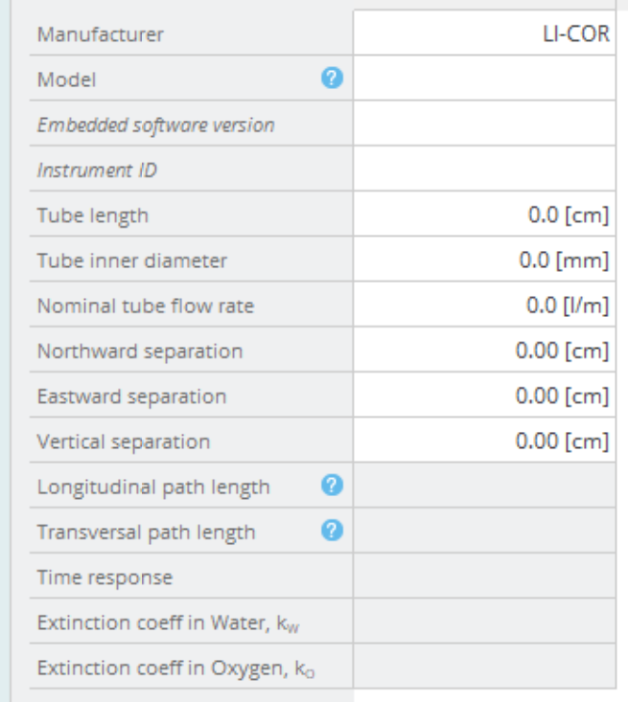
Instruments, part 2
600 cm (6 meters) for Silas Little
4.0 mm mostly, some
5 – 7 liters per minute
0 cm
15.0 cm
0 cm

Slide 4
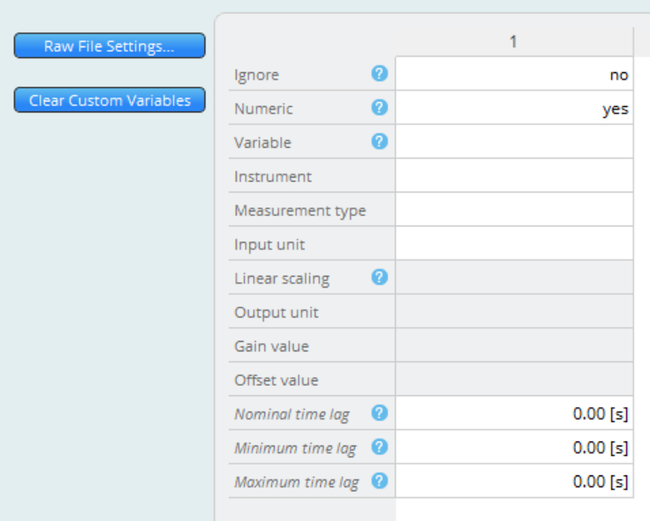
Raw file description
No need to ignore any values. I do not think there are any spikes in these data sets. Yes to numeric.
Instruments are RM Young 81000v and LI-COR 7000.
3.00 sec
1.00 sec
5.00 sec

